Slide 1
Prototype Big Data Archive in a Public Cloud
Client: David Barber
Instructor: D. Kevin McGrath, Kirsten Winters
Group 56: Zhi Jiang, Isaac Chan, Zhaoheng Wang

Slide 2
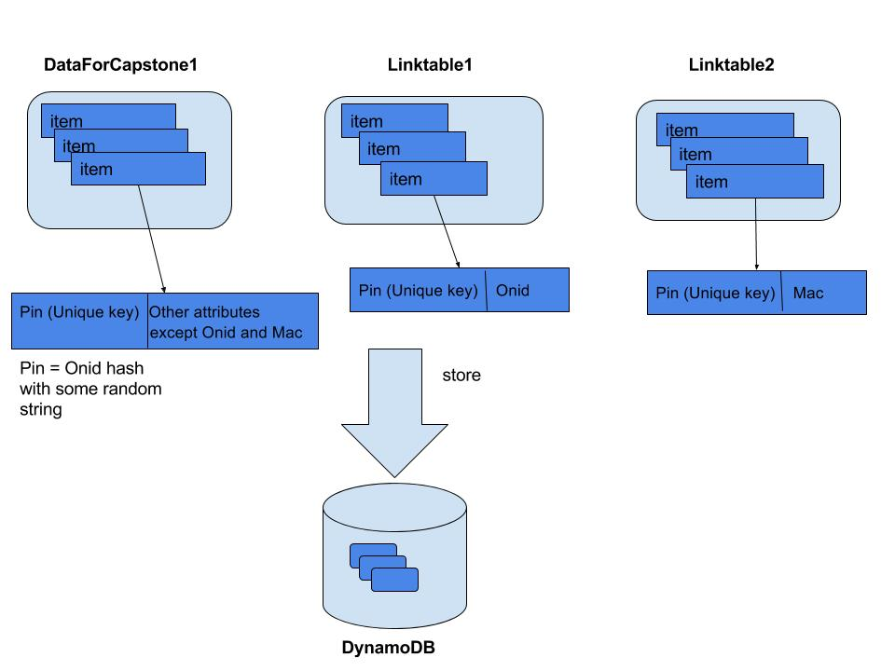
DynamoDB Table Structure
Zhaoheng Wang

Slide 3
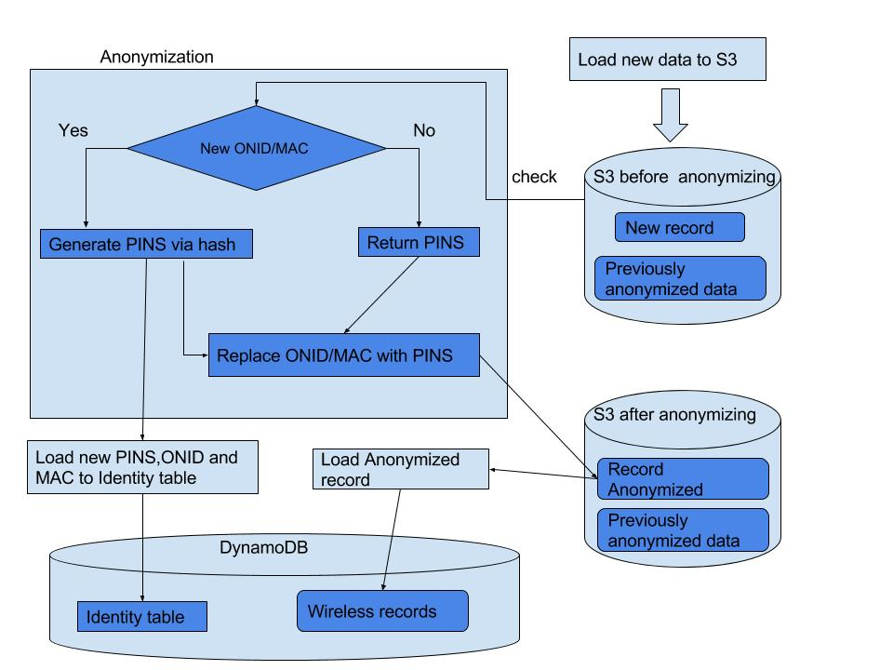
Workflow for loading New Data
Zhaoheng Wang

Slide 4




Importing data from S3 to DynamoDB
Zhi Jiang
Amazon S3
Amazon DynamoDB

Slide 5
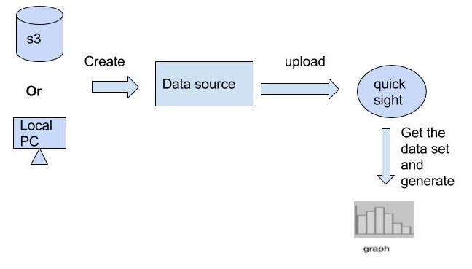
QuickSight
Zhaoheng Wang

Slide 6
Tests for Functionality
Isaac Chan
Originally analysis
Shifted requirements to standardizing raw data

Slide 7
Performance & Security
Isaac Chan
Their expected data size is processed with ease in AWS
AWS permissions and hashing

